Slide 1
ZAVA
BEVERAGES
Z
Hibiscus refreshment,
rooted in Uganda
Formulated in Botswana · Early tastings in Francistown and Gulu
NON-CARBONATED
HIBISCUS DRINK
Investor discussion draft | October 2026
Notes:
Discussion draft based on founder-provided information. The product is at development stage; the deck does not claim commercial production, verified shelf life, sales traction, or investor commitments.

Slide 2
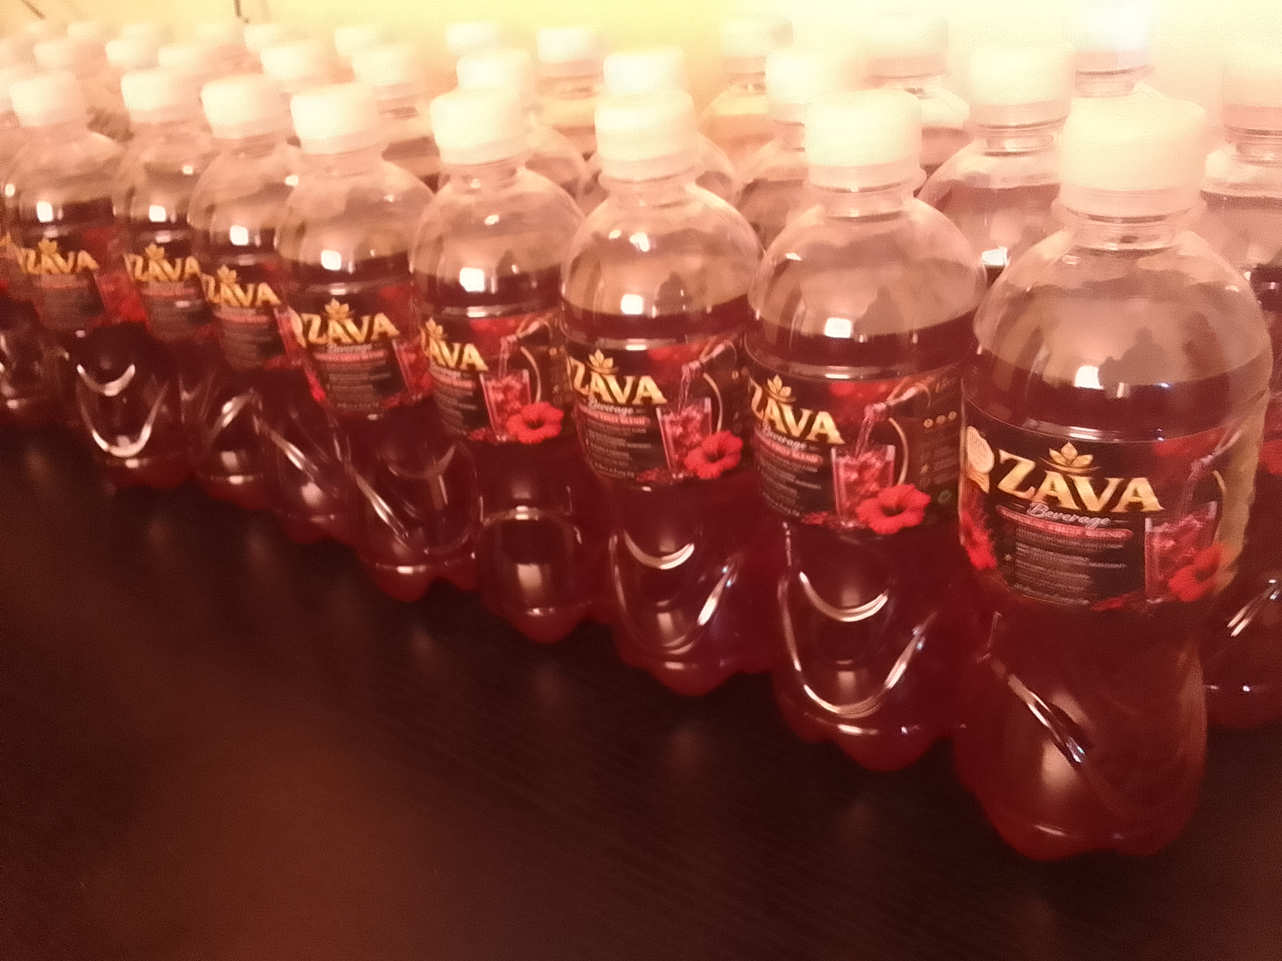
01 | PRODUCT
The product
A non-carbonated drink made with hibiscus
ZAVA is built around Hibiscus sabdariffa. The current beverage has been formulated and produced in small home batches.
DEVELOPMENT STATUS
Formulated · Sample bottles produced · Pilot manufacturing setup still required
Founder-provided photo · prototype bottles
ZAVA BEVERAGES | INVESTOR DISCUSSION DRAFT
02
Notes:
Photo supplied by the founder showing prototype bottles. Packaging and labels shown are not confirmed as final commercial packaging or approved labels.

Slide 3
02 | INITIAL MARKET SIGNALS
Early response and price position
Tasted in two cities
Founder-reported affordability
Francistown, Botswana
Gulu City, Uganda
The founder reports ZAVA is priced below competing drinks in the target market and that the price helped vendors sell it.
The founder reports overwhelmingly positive informal feedback from initial tastings, including local vendors in Gulu.
NEXT EVIDENCE TO COLLECT
Taster count and method
Comparable pack prices
Units sold and repeat orders
Early qualitative feedback; not yet representative consumer research or verified sales traction.
ZAVA BEVERAGES | INVESTOR DISCUSSION DRAFT
03
Notes:
Founder-reported information. Do not state sample size, survey percentages, sell-through, repeat purchase, or comparative price advantage as verified until records are collected. For price comparisons, record date, brand, pack volume, channel, location, shelf price, and price per litre.

Slide 4
03 | TEAM AND BASE
Founder and starting assets
Founder
Ugandan operating base
Pharmacist with postgraduate training in research
Pke Insights is registered in Uganda. The founder reports owning premises and land in Gulu and having the ownership documents.
The founder developed the hibiscus beverage formulation and reports capability to create multiple flavours while maintaining the desired taste profile.
Founder estimates: US$10,000 to convert the existing building and install a suitable fence; US$30,000 for a new build on owned land. Written scopes and quotes are pending.
Investor diligence: confirm credentials, company records, title documents, and the operating company’s right to use the property.
ZAVA BEVERAGES | INVESTOR DISCUSSION DRAFT
04
Notes:
Founder credentials and property ownership are founder-reported and should be evidenced with qualification and title documents. Pke Insights company details and activities should be checked before an investment structure is selected.

Slide 5
04 | LOCATION
Gulu production base and logistics
Gulu City
FUTURE REGIONAL OPPORTUNITY
South Sudan
Eastern DRC
Proposed first production and market-validation base
Founder reports the premises are a short distance from the Gulu Logistics Hub, an intermodal cargo facility.
Potential markets to assess after Uganda pilot evidence, freight routes, import requirements, and buyer demand are confirmed.
Railway rehabilitation is a potential enabler, not a confirmed operating route or launch date.
ZAVA BEVERAGES | INVESTOR DISCUSSION DRAFT
05
Notes:
Uganda Railways Corporation describes the Gulu Logistics Hub as serving national and international goods transit and the Tororo–Gulu line as terminating at the hub. URC currently lists Tororo–Gulu as non-operating. Government status pages reported work in progress and a target date of 22 October 2026, which had passed by the date of this deck without a completion confirmation. Verify the current status before circulation. Sources: https://urc.go.ug/?p=2327 ; https://urc.go.ug/who-we-are/ ; https://doingbusiness.finance.go.ug/reforms/prioritise-construction-of-the-sgr-and-completion-of-mgr-rehabilitation-to-upgrade-logistics-corridors

Slide 6
05 | COMMERCIAL PLAN
A measured route to market
01
Pilot in Gulu
02
Measure demand
Confirm production readiness, run a controlled batch, and test with selected vendors and consumers.
Track units offered and sold, price response, retailer feedback, and repeat purchase.
03
Expand selectively
Potential channels
Use local bloggers and influencers for a small, trackable campaign; assess wider Ugandan distribution before cross-border expansion.
Local vendors · Retailers · Hospitality · Distributors
ZAVA BEVERAGES | INVESTOR DISCUSSION DRAFT
06
Notes:
The route to market is a proposed plan. Vendor feedback, influencer access, and channels are founder-reported. Confirm supply capability, pricing, and channel economics before scaling.

Slide 7
06 | PORTFOLIO
Product range and roadmap
NOW
NEXT TO TEST
LATER RESEARCH
Hibiscus drink
Ice pops
Skincare
Non-carbonated core beverage; multiple flavour variations reported by the founder.
Potential ZAVA format extension. Requires separate recipe, food-safety, freezing, cold-chain, and margin validation.
Early research concept using hibiscus. No skin-healing benefit is claimed or validated.
Focus first: establish one reliable beverage product and a commercially viable pilot.
ZAVA BEVERAGES | INVESTOR DISCUSSION DRAFT
07
Notes:
Ice pops and skincare are roadmap concepts, not products currently available for sale. Food and cosmetic requirements differ. Avoid therapeutic or skin-healing claims without evidence and regulatory review.

Slide 8
07 | MILESTONES
Production readiness and validation
The founder reports home-produced bottles showed no visible mould or obvious spoilage for several months under the conditions used.
This is an early observation, not independent proof of microbiological safety or a commercial shelf life.
Site
Equipment
UNBS and testing
Assess conversion vs. new build, utilities, hygiene layout, and inspection requirements.
Obtain pilot-scale equipment or co-packer quotes, capacity, minimum runs, and lead times.
Review CIMS online application pathway; confirm product standard, site readiness, tests, fees, and labels.
ZAVA BEVERAGES | INVESTOR DISCUSSION DRAFT
08
Notes:
UNBS confirms online CIMS product certification applications and lists a valid email, URA TIN, product label/markings, URSB business registration certificate, and production process description/flowchart among guidance items. Confirm the exact standard and current requirements with UNBS. Sources: https://cims.unbs.go.ug/ ; https://unbs.go.ug/news-highlights.php?news=199&read= ; https://unbs.go.ug/content.php?pg=content&src=product-certification

Slide 9
08 | PARTNERSHIP
Capital to reach a defined pilot
Potential use of funds
Structure to discuss
Site options (founder estimates):
• Existing building conversion + fence: US$10,000
• New build on owned land: US$30,000
Other needs: equipment or contract production, safety and shelf-life tests, packaging, ingredients, and controlled market validation.
A dedicated ZAVA company is the initial option to explore for significant outside equity. Investment through Pke Insights remains open after company-level diligence.
Site figures are preliminary founder estimates; scope, suitability, inclusions, and written quotes remain to be confirmed. They exclude any costs not explicitly priced.
Open to an investor, production partner, distributor, or a combination.
ZAVA BEVERAGES | INVESTOR DISCUSSION DRAFT
09
Notes:
The founder estimates US$10,000 for existing-building conversion and suitable fencing, and US$30,000 for a new build on owned land. These are not supplier quotes or complete budgets. Confirm site suitability, exact scope, inclusions, approvals, utilities, and timelines. No fundraising amount, valuation, return, or financial projection is stated because supporting cost data has not yet been provided. The company structure requires Ugandan legal and tax advice and investor due diligence.

Slide 10
Build the Gulu pilot
with the right partner
ZAVA is preparing to move from formulation and early feedback to compliant pilot production and measured customer demand.
DISCUSSION POINTS
Pilot scope · Capital and partner contribution · Company structure · Milestones
ZAVA BEVERAGES | DISCUSSION DRAFT
Notes:
The founder can add direct contact information when sharing the deck with a named investor. This draft does not contain a public offer of securities.

